Slide 1


ELEMENTS OF BIOLOGY: PROJECT PRESENTATION
BUTTERFLY WINGS
INSPIRED
PHOTOVOLTAIC ABSORBERS
OCTOBER, 2022

Slide 2


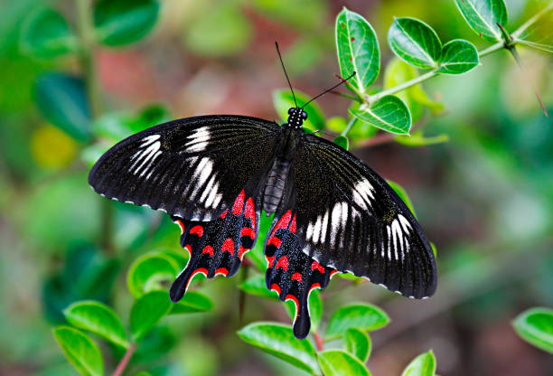

INTRODUCTION
The wings of the black butterfly, Pachliopta aristolochiae, are covered by micro- and nanostructured scales that harvest sunlight over a wide spectral and angular range.
Considering that these properties are particularly attractive for photovoltaic applications, we analyze the contribution of these micro- and nanostructures, focusing on the structural disorder observed in the wing scales.
The nanopatterned absorbers created, achieve a relative integrated absorption increase of 90% at a normal incident angle of light to as high as 200% at large incident angles, demonstrating the potential of black butterfly structures for light-harvesting purposes in thin-film solar cells.

Slide 3
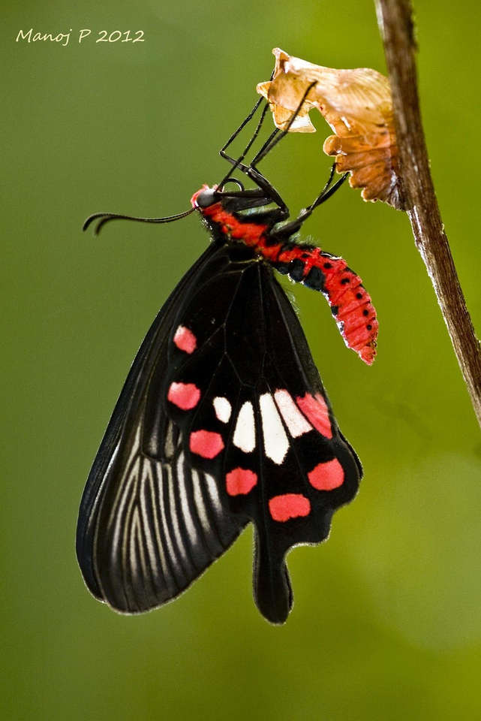
Pachliopta aristolochiae
Also known as the common rose, is a swallowtail butterfly belonging to the genus Pachliopta, are red-bodied swallowtails.
It is a common butterfly which is extensively distributed across south and southeast Asia.
Evolution-driven photonic structures in nature, such as those found in these butterflies can effectively manipulate the flow of light for camouflage, inter- or intraspecies communication, signaling, heat regulation, and many other biological processes.

Slide 4
WHY DO WE USE THE
BLACK-WINGED BUTTERFLY
FOR MIMICRY IN THIN PHOTOVOLTAIC ABSORBERS?
Mimicking these optimized photonic prototypes plays an unprecedented important role in the design and function of optoelectronic devices and technologies.
In thin-film solar cells, where efficiencies are limited by severe optical losses, using photonic structures was shown to improve light collection and to assist light trapping of low-energy photons.
In particular, randomly textured surfaces and periodic structures have been extensively investigated because of their ease of implementation via wet etching or low-pressure deposition, and interference or nanoimprint lithography techniques, respectively.
The scales of black butterflies’ wings exhibit a wide variety of hierarchical micro- and nanostructures with specific functionalities such as visual appearance and thermoregulation.

Slide 5
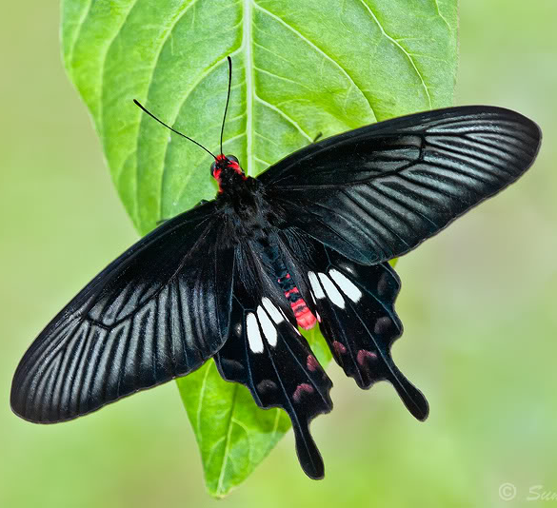
BRIEF ON
ANALYSIS
The absorption is first examined experimentally by micro spectroscopy.
The analysis conducted in this paper enables probing of wings locally and relates the structural variations, particularly the air-filling fraction, to the observed optical properties.
Using the finite element method (FEM), we analyze the respective influence of the micro- and nanostructures on the resulting absorption properties together with the wavelength-dependent light propagation mechanisms.

Slide 6
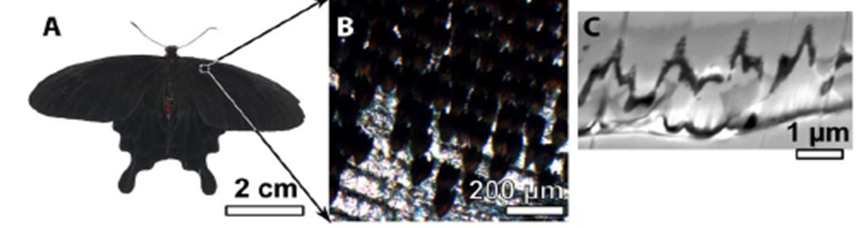
ANALYSIS AND CHARACTERIZATION OF THE
BLACK BUTTERFLY SCALES:
The basal region near the thorax is matt black on both forewing and hindwing, and is darker than any other black regions of the wing of P. aristolochiae (see Fig. A and B)
For both matt black and dull black regions of the wings, the hole diameters follow a random distribution with a mean of 300 ± 85 nm

Slide 7

As illustrated in Fig. (B to D), the scales display different colors when the ff changes, suggesting that the absorption properties strongly correlate to this morphological feature
There is quantitative absorption difference between those two sections
This absorption difference increases even more for wavelengths above 800 nm and reaches up to 18% at 900 nm
The following results suggest that the higher the ff, the lower the reflection and consequently the better the absorption
We performed FEM-based simulations and the “3D model” parameters for these simulations were taken from surface and cross-sectional SEM images

Slide 8
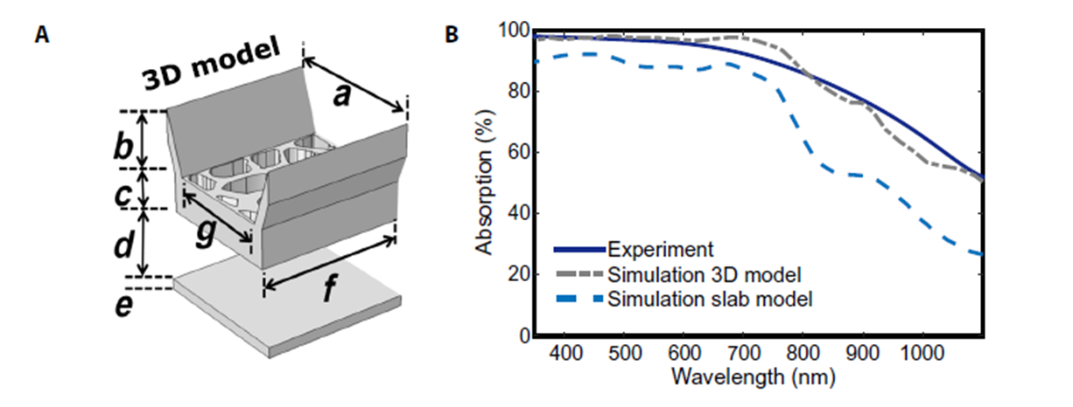
An unpatterned slab with an equivalent absorbing material volume was used as a reference
The optical index data of the melanin-chitin composite were adopted from the wavelength-dependent complex permittivity
Fig. B shows that structuring the absorbing medium, as found in the scales of the black butterfly, leads to a marked increase in the absorption over the whole spectral range considered
The absorption enhancement is more prominent in the near infrared (NIR) region (20 to 35%) than in the visible range (15 to 20%)

Slide 9
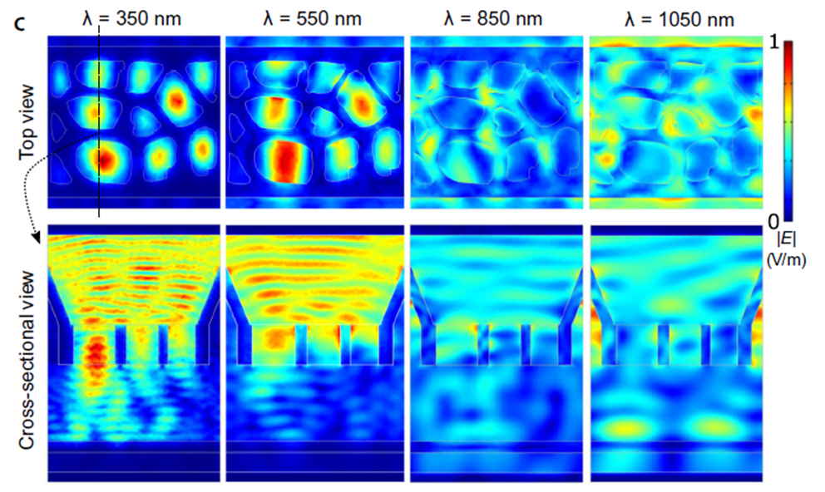
The light propagation through the architecture was investigated by using field mapping at four different wavelengths
The ridges start playing a noticeable role on the light propagation mechanism in the NIR, as observed in Fig. C

Slide 10
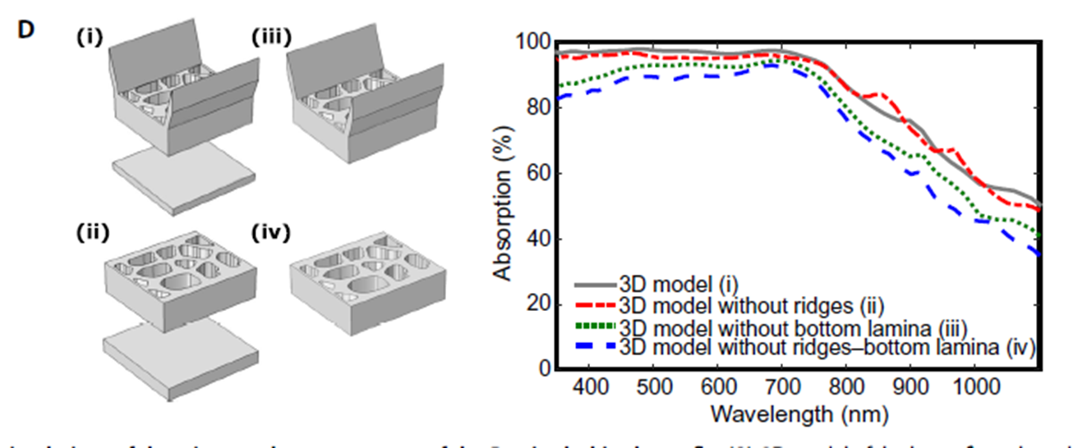
Figure D singles out the individual role of different components of butterfly scale morphology in the total light absorption
The selected wavelengths correspond to a value slightly higher than the mean nanohole diameter (350 nm), above the maximum nanohole diameter (850 nm), and covering several nanoholes
At 350 nm, simulated field maps show that the light does not pass through the ridges
This mechanism is efficient enough for sustaining a high absorption at short wavelengths, as highlighted by the low absorption difference between the configurations with and without the bottom slab (see Fig. D)

Slide 11
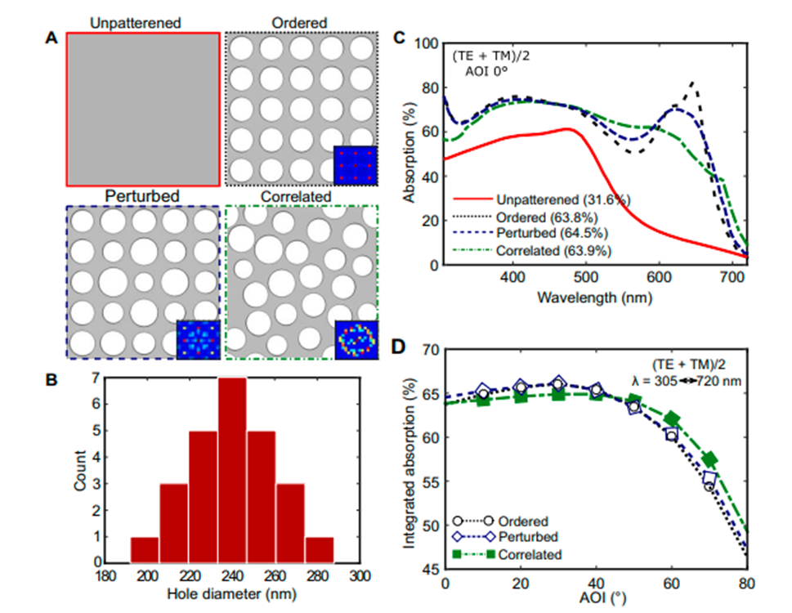
DESIGNING THIN-FILM ABSORBERS INSPIRED BY
BLACK BUTTERFLY SCALES:
Photonic structures with three different hole arrangements are considered
They were drilled into a thin layer made of a - Si:H, a commonly used thin-film PV absorber
More precisely,
An “ordered” periodic arrangement of holes with a single diameter
A “perturbed” periodic arrangement of holes with varying diameters
A “correlated” combination of position and diameter size disorder inspired by the black butterfly scales
An unpatterned slab with a thickness of 100 nm served as a reference

Slide 12
The IA was calculated to assess the light-harvesting capability of the four different photonic structures under consideration
In the unpatterned reference slab, the IA is only 31.6%
The photonic slab with ordered hole array exhibits 63.8% of the average optical absorptivity weighted by solar spectral irradiance in the wavelength range between 305 and 720 nm
However, the perturbed structure has an increased IA of 64.5%
Introducing correlation on the position of the holes together with size dispersion, similar to the black butterfly, leads to an IA of 63.9%
The bioinspired correlated designs have a richer collection of absorption peaks and are therefore less sensitive to angular effects
This qualitative analysis is consistent with the IA values reported in Fig. D and enables us to stress the advantage of bioinspired disordered nanohole distribution over the periodic ones because it optimizes the absorption over a broad spectral and angular range

Slide 13
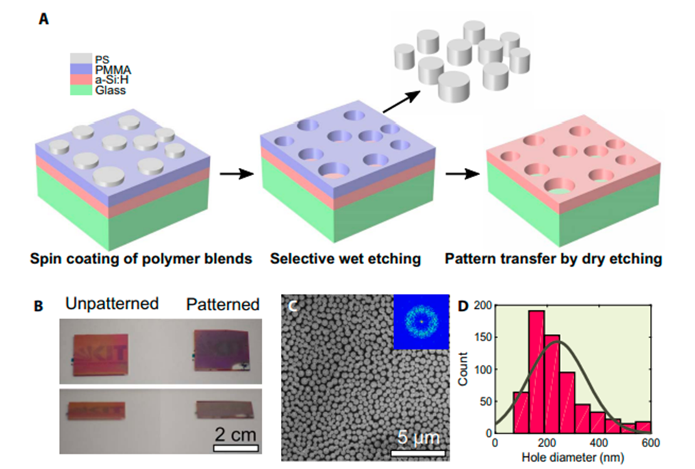
FABRICATION OF THIN-FILM ABSORBERS INSPIRED BY
BLACK BUTTERFLY SCALES:
Motivated by the positive outcome of the simulations, we fabricated bioinspired thin-film absorbers using lateral phase separation of polymer blends and reactive ion etching (RIE)
The nanoholes were transferred into a 130-nm-thick a-Si:H layer by RIE using the patterned resist layer as an etching mask
A corresponding 2D Fourier power spectrum in the inset of the overview SEM image demonstrates the correlated disorder nature of the nanoholes, confirming the similarity with the previously discussed black butterfly structures

Slide 14
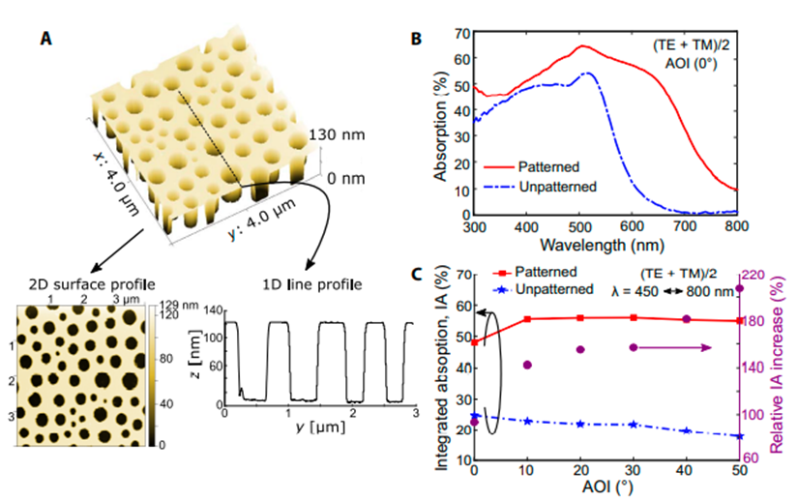
The hole diameters follow a Gaussian distribution and range between 100 and 600 nm with a mean diameter of 238 nm, which is close to the optimized mean value of 240 nm previously considered in the optical simulations
Figure A shows an atomic force microscopy (AFM) image of the nanoholes etched into the a-Si:H layer
The resulting absorption spectrum of the patterned a-Si:H layer at a normal AOI is shown in Fig. B

Slide 15


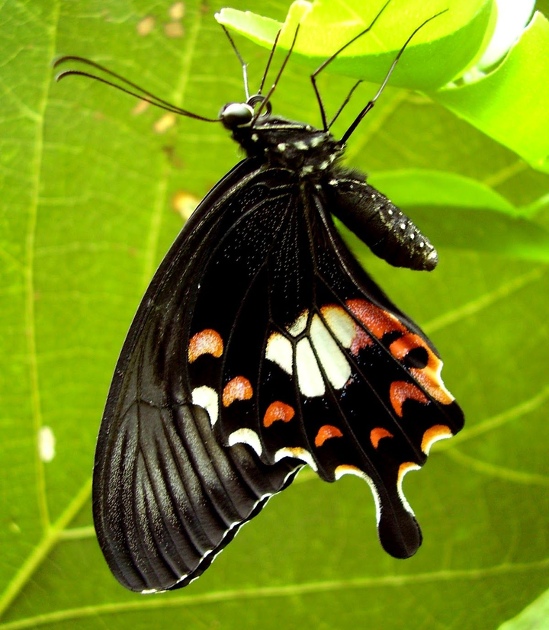




METHODS
Patterning of thin-film PV absorbers
Optical Simulations
Bioinspired thin films
P. aristolochiae wing micro- and nanostructures

Slide 16
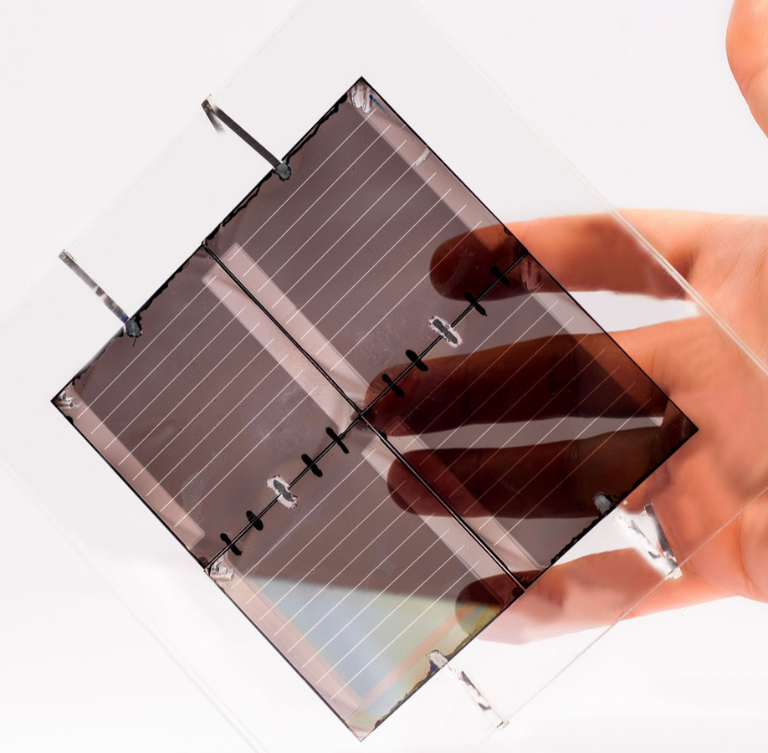
PATTERNING OF THIN-FILM
PV ABSORBERS
a-Si:H (130 nm thick) was deposited on Corning glass substrates using plasma-enhanced chemical vapor deposition at a plasma excitation frequency of 13.56 MHz and a substrate temperature of 180°C
The demixing of the blend components out of the smooth surface occurred during spin coating
Afterward, the pattern was transferred into the a-Si:H layer by RIE (Oxford 80 Plasma lab Etcher) using the PMMA layer as an etching mask

Slide 17
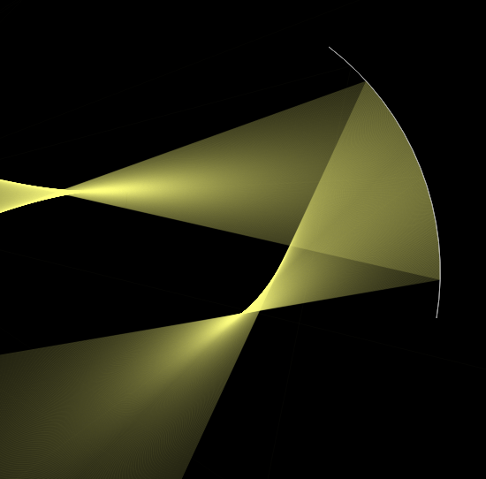
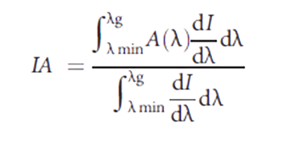
OPTICAL SIMULATIONS
Periodic boundary conditions in the lateral directions (x and y) were applied in all calculations. An incoming plane wave impinging the structures under normal incidence was used, and all the calculations were performed with a spatial resolution of 5 nm
The boundary conditions of the electromagnetic fields in the vertical (z) direction were set on the perfect matching layer for the model
The IA of the structures is defined as the integration of the absorption,

Slide 18

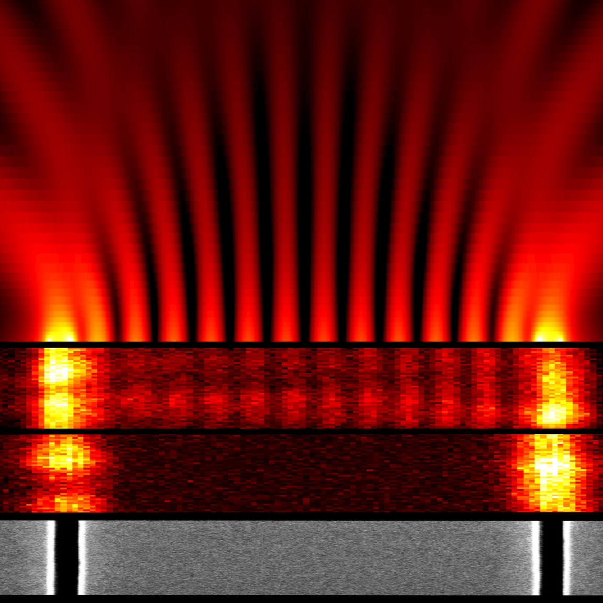
P. ARISTOLOCHIAE WING
MICRO- AND NANOSTRUCTURE
The parameters of the 3D FEM model of the P. aristolochiae wing nano and microstructures were obtained from SEM images. The IA was calculated from 350 nm (lmin) to 1100 nm (lg)
BIO INSPIRED
THIN FILMS
The correlated thin-film configuration was generated using a freely available based on the LS algorithm
The final structure was then obtained by recording the position of the center of the discs and using these coordinates

Slide 19
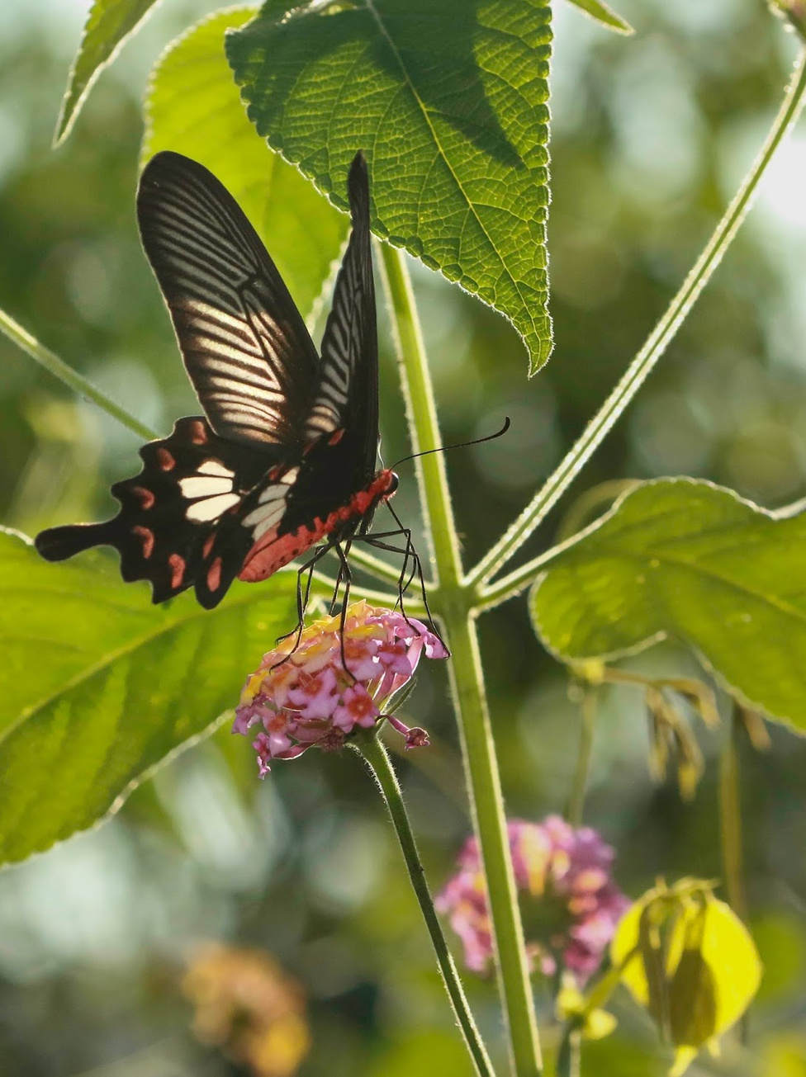




CHARACTERIZATION
Macrospectroscopic analysis
Microspectroscopic analysis
Topographical analysis
High-resolution imaging

Slide 20
MACROSPECTROSCOPIC
ANALYSIS
The research paper says that macroscopically measured the overall reflection (at 8° AOI) and transmission spectra of the P. aristolochiae wings and the fabricated bioinspired a-Si:H absorbers
The measurements were performed with a custom-built motorized integrating sphere apparatus
Transmission measurements were normalized to the uncovered area of the underlying glass slide, whereas reflection measurements were normalized to a reflectance standard (Labsphere) within the sphere

Slide 21
MICROSPECTROSCOPIC
ANALYSIS
A customized Zeiss Axio microscope with a spot diameter of≈25 mmin bright-field reflection and transmission mode with a halogen lamp in Koehler illumination was used for the microspectroscopic analysis of individual scales
The transmitted and reflected light was collected with a spectrometer

Slide 22
TOPOGRAPHICAL
ANALYSIS
ImageJ, a public domain and Java-based image processing program tool, was used to perform the statistical analysis of the nanohole size on the wing membrane
The 2D Fourier power spectra were obtained from the presented SEM images and calculated with the FFT algorithm of MATLAB

Slide 23
HIGH-RESOLUTION IMAGING
ANALYSIS
Cross-sectional imaging was performed to design the 3D model for FEM simulation. For that, small pieces of wings were embedded in epoxide resin
First, the pieces were dipped in a combination of 70% acetone and 30% epoxidemix
They were exposed to vacuum for a few minutes to remove air bubbles
Afterward, the mixture was shaken for an hour
This step was first repeated and then twice with 100% epoxide mix to ensure that the viscous resin penetrated into all the tiny cavities of the butterfly scales
The polymerized block was removed from the mold and trimmed to expose the wing piece

Slide 24
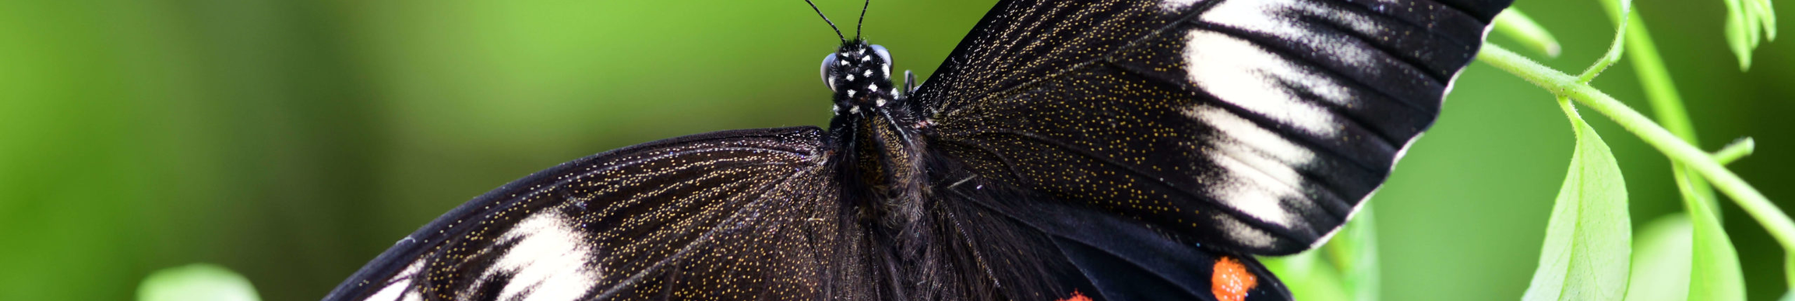
RESEARCH PAPER
DISCUSSION
The wings of P. aristolochiae have a hierarchical design based on ridges and nanoholes to simultaneously provide good mechanical stability and efficient light harvesting.
Using microspectroscopy, the paper experimentally correlated the absorption enhancement along the scale with an increase in ff.
The paper sets up a 3Dmodel based on SEM images and calculated its absorption using FEM simulations.
It concludes that most of the absorption takes place in the hierarchical structure in the upper lamina, with a weak contribution from the ridges especially below 800 nm.
Conversely, the nanohole array plays a major role in the visible range with respect to the light in coupling properties.
In both simulations and experiments, the wings’ absorption thus plateaued above 95% between 300 and 800 nm.

Slide 25

RESEARCH PAPER
DISCUSSION
It is noted that light propagation within the black butterfly biostructures could be further analyzed using artificial, scaled-up samples produced by, for example, 3D printing stereolithography.
In contrast to original butterfly scales, a circular shape of holes is considered in the study, because that shape can be obtained in the fabrication approach.
To produce a disordered structure of nanoholes inspired by the black butterfly scales, the paper uses a self-assembly technique with controllable ff and hole diameter distribution. The method used has several advantages over conventional lithography because of its simplicity and scalability.
This study uniquely ventures into the territory of combining bioinspired nanostructures with thin-film PV absorbers, improving their functionality by a factor of 2. They also provide a pathway for further systematic study of nature-inspired nanostructures for optimal design and function of PV devices.

Slide 26

DISCUSSION
CRITICS
The absorption enhancement achieved by this study is limited at around 350 nm.
The etching through the whole a - Si : H layer thickness leads to high transmission losses.
Because the absorber was thin compared to the simulated black butterfly structure, the channeled light cannot be fully absorbed in a single pass.
However, this issue is circumvented in a complete solar cell stack including a rear reflector.
Although substantial, this absorption enhancement in a - Si:H does not reach that obtained in the single-patterned slab because of the suppressed transmission losses (back reflector) and the parasitic absorption taking place in all the other layers.

Slide 27
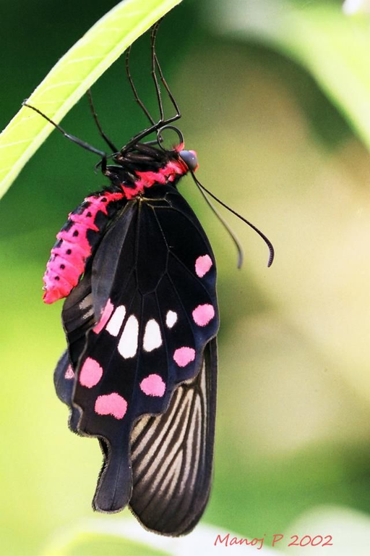
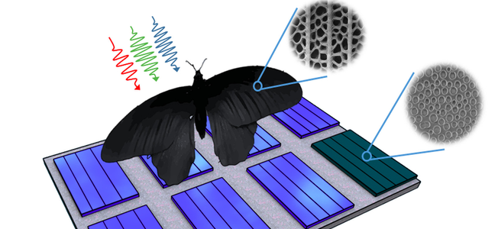
DETAILS OF
CONTRIBUTION
AMISHI:
introduction [slide 2]
analysis [slide 6-10]
methods & characterization [slide 15-23]
discussion [slide 24-25]
CHAHEL:
introduction [slide 2]
why this butterfly? [slide 3-5]
design & fabrication [slide 11-14]
discussion [slide 24-26]

Slide 28

THANK YOU
C044, Amishi Desai
C049, Chahel Gupta
MPSTME, B.Tech Integrated (Computers)
Division: B, Semester V
2022
Reference Paper:
R. Siddique, Yidenekachew J. Donie, G. Gomard, S. Yalamanchili, T. Merdzhanova, U. Lemmer, H. Hölscher (October, 2017). "Bioinspired phase-separated disordered nanostructures
for thin photovoltaic absorbers." Science Advances [Online]. Vol. 3, Issue 10. Available: https://www.science.org/doi/10.1126/sciadv.1700232

